Slide 1
An easy to use RPC framework
implemented by C++11/14
Yu Qi
qicosmos@163.com

Slide 2
Outline
1.Introduction to RPC
2.What is rest_rpc?
3.Ease of use challenges
4.Key technologies
5.What can you do with it?

Slide 3
Introduction to RPC
Remote Procedure Calls
Call functions on the remote computer just like local function calls
Advantages:
Very easy to use, hide complications and details of network and framework
Greatly improve the efficiency of the development of interprocess communication

Slide 4
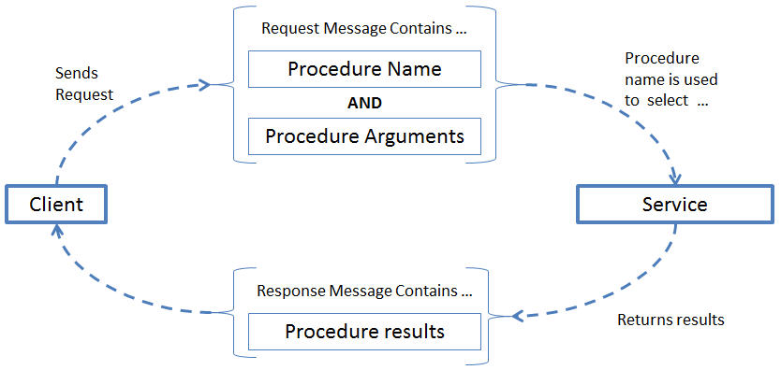
Introduction to RPC

Slide 5
Outline
1.Introduction to RPC
2.What is rest_rpc?
3.Ease of use challenges
4.Key technologies
5.What can you do with it?

Slide 6
Existing RPC frmework
grpc:
service Greeter {
rpc SayHello (HelloRequest) returns (HelloReply) {}
}
message HelloRequest {
string name = 1;
}
message HelloReply {
string message = 1;
}

Slide 7
Existing RPC frmework
//business logic RPC service
class GreeterServiceImpl final : public Greeter::Service {
Status SayHello(ServerContext* context, const HelloRequest* request,
HelloReply* reply) override {
std::string prefix("Hello ");
reply->set_message(prefix + request->name());
return Status::OK;
}
};

Slide 8
Existing RPC frmework
void RunServer() {
std::string server_address("0.0.0.0:50051");
GreeterServiceImpl service;
ServerBuilder builder;
builder.AddListeningPort(server_address, grpc::InsecureServerCredentials());
builder.RegisterService(&service);
// Finally assemble the server.
std::unique_ptr<Server> server(builder.BuildAndStart());
server->Wait();
}

Slide 9
Existing RPC frmework
Problems :
need to define a protocol file, complication and learning cost
many restrictions, must inherit, no freedom
just only support one protocol, how about json, xml, custom protocol?
you should know many details of framework and network

Slide 10
What is rest_rpc
server code:
//business logic
int add(int a, int b) { return a + b; }
int main()
{
using server_t = rpc::server<rpc::msgpack_codec>; //define serialization policy
server_t server{ port, pool_size, std::chrono::seconds{ 2 } };
server.register_handler("add", add); //register business handler
server.start();
}
No protocal file
No limitations
Support many kinds of serialization

Slide 11
What is rest_rpc
rest_rpc is an open source RPC library
link: https://github.com/topcpporg/rest_rpc
easy to use
rapid development
flexible

Slide 12
What is rest_rpc
client code:
TIMAX_DEFINE_PROTOCOL(add, int(int, int));
int main()
{
rpc::sync_client<msgpack_codec> client;
auto endpoint = timax::rpc::get_tcp_endpoint("127.0.0.1", 9000);
//RPC request contains service name and arguments
auto result = client.call(endpoint, add, 1, 2);
assert(result == 3);
}

Slide 13
class GreeterClient {
public:
GreeterClient(std::shared_ptr<Channel> channel) : stub_(Greeter::NewStub(channel)) {}
std::string SayHello(const std::string& user) {
HelloRequest request;
request.set_name(user);
HelloReply reply;
ClientContext context;
// The actual RPC.
Status status = stub_->SayHello(&context, request, &reply);
}
private:
std::unique_ptr<Greeter::Stub> stub_;
};

Slide 14
int main(int argc, char** argv) {
GreeterClient greeter(grpc::CreateChannel(
"localhost:50051", grpc::InsecureChannelCredentials()));
std::string user("world");
std::string reply = greeter.SayHello(user);
return 0;
}

Slide 15
What is rest_rpc
Sever core code:
int add(int a, int b) { return a + b; } //business logic
using server_t = rpc::server<rpc::msgpack_codec>; //define serialization policy
server.register_handler("add", add); //register business handler
Client core code:
TIMAX_DEFINE_PROTOCOL(add, int(int, int));
rpc::sync_client<msgpack_codec> client;
auto result = client.call(endpoint, add, 1, 2);
No protocal file
No limitations
Support many kinds of serialization

Slide 16
Outline
1.Introduction to RPC
2.What is rest_rpc
3.Ease of use challenges
4.Key technologies
5.What you can do with it

Slide 17
Challenges
How to register callable of any signature
How to route to the correct handler
How to simplify the call code

Slide 18

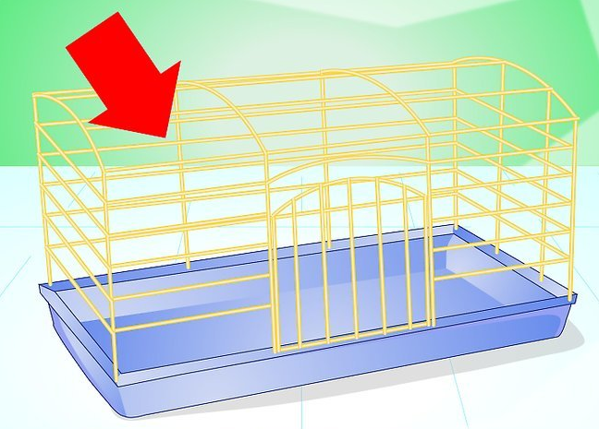
Challenges

Slide 19
Outline
1.Introduction to RPC
2.What is rest_rpc?
3.Ease of use challenges
4.Key technologies
5.What can you do with it?

Slide 20
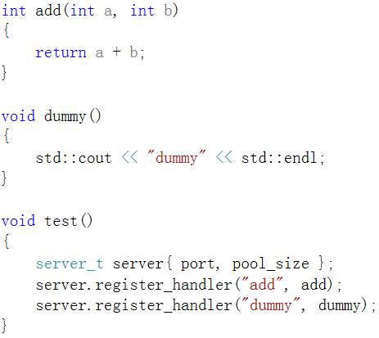
Register callable of any signature
different kinds of functions
in a same container

Slide 21
Register callable of any signature
C++ has no such a container
type erase

Slide 22
Type erase
No!
The number of types is limited

Slide 23
Type erase
No!
can’t any_cast
lost type information
modern c++ can solve the problem

Slide 24
Register callable of any signature
A special type erase
template<typename Function>
struct invoker
{
static inline void apply(const Function& func, char const*, size_t){}
};
carry function type information
can accept any callable
return type
arguments type
reference
const volatile
……
int
int&
int&&
const int&
……

Slide 25
Register callable of any signature
type erase
std::bind(&invoker<Function>::apply, f, _1, _2)

Slide 26
Register callable of any signature
struct server_t{
template<typename Function>
void register_handler(std::string const & name, const Function& f){
using std::placeholders::_1;
using std::placeholders::_2;
this->invokers_[name] = { std::bind(&invoker<Function>::apply, f, _1, _2)
};
private:
std::map<std::string, std::function<void(char const*, size_t)>> invokers_;
};
invoker<Function>::apply

Slide 27
Register callable of any signature
server_t server;
server.register_handler("add", [](int a, int b) {return a + b; });
server.register_handler("dummy", []{ });
server.register_handler("get_str", [](double v) { std::to_string(v); });

Slide 28
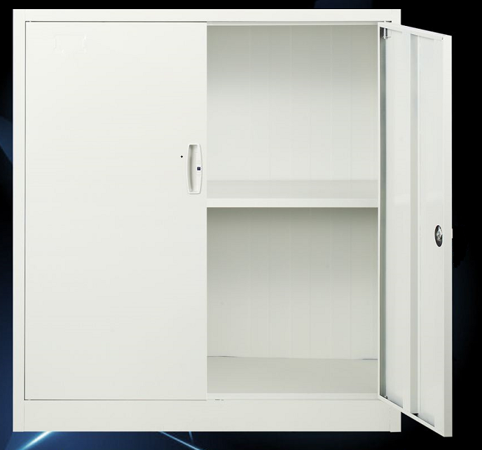

How to route to the correct handler

Slide 29
How to route to the correct handler
template <typename CodecPolicy>
struct server_t{
template<typename Function>
void register_handler(std::string const & name, const Function& f){
using std::placeholders::_1;
using std::placeholders::_2;
this->invokers_[name] = { std::bind(&invoker<CodecPolicy, Function>::apply, f, _1, _2) };
}
void route(const std::string handler_name, char const* data, size_t size) const{
auto it = invokers_.find(handler_name);
it->second(data, size);
}
private:
std::map<std::string, std::function<void(char const*, size_t)>> invokers_;
};
register_handler
route

Slide 30
How to route to the correct handler
template<typename CodecPolicy, typename Function>
struct invoker{
static inline void apply(const Function& func, char const* data, size_t size) {
CodecPolicy cp{};
auto args_tuple = cp.template unpack<args_tuple_type>(data, size);
std::apply(func, args_tuple);
}
};
//from C++17
T t;
iguana::xml::from_json(t, data, length);
iguana::msgpack::from_msgpack(t, msg_, data, length);
iguana::xml::from_xml(t, data, length);
https://github.com/qicosmos/iguana

Slide 31
How to route to the correct handler
template <class F, class Tuple, std::size_t... I>
constexpr decltype(auto) apply_impl(F &&f, Tuple &&t, std::index_sequence<I...>)
{
return std::forward<F>(f)(std::get<I>(std::forward<Tuple>(t))...);
}
template <class F, class Tuple>
constexpr decltype(auto) apply(F &&f, Tuple &&t)
{
return apply_impl(std::forward<F>(f), std::forward<Tuple>(t),
std::make_index_sequence<std::tuple_size<std::decay_t<Tuple>>::value>{});
}
implemented by C++14

Slide 32
How to route to the correct handler
void add(int a, int b){
std::cout << a + b << std::endl;
}
void foo(std::string b, int a){
std::cout << b << std::endl;
}
router r;
r.register_handler("add", &add);
r.register_handler("fun", &foo);
string s1 = "add/1/2"; //url from client
string s2 = "fun/test/1";
r.route(s1); //route and execute
r.route(s2); //route and execute

Slide 33
How to route to the correct handler
How about url?
url: "hello/test/20"
string to function call
function: void hello("test", 20)
magic

Slide 34
How to route to the correct handler
How to？
Split url, put them into a string vector {"hello", "test", "20"}；
Transform string parameters into function argument；
transform a string to a real argument by function_traits
save the real argument into a tuple one by one
std::apply
"hello/test/20"
`
hello("test", 20)

Slide 35
How to route to the correct handler
template<typename Ret, typename... Args>
struct function_traits_impl<Ret(Args...)>{
enum { arity = sizeof...(Args) };
typedef Ret result_type;
using stl_function_type = std::function<function_type>;
template<size_t I>
struct args{
static_assert(I < arity, "index is out of range");
using type = typename std::tuple_element<I, std::tuple<Args...>>::type;
};
};
template<typename T>
struct function_traits : function_traits_impl<
std::remove_cv_t<std::remove_reference_t<T>>>{};
https://github.com/topcpporg/rest_rpc/blob/master/rest_rpc/base/function_traits.hpp

Slide 36
How to route to the correct handler
struct router
{
template<typename Function>
void register_handler(std::string const & name, const Function& f)
{
using std::placeholders::_1;
this->invokers_[name] = std::bind(&invoker<Function>::template apply<std::tuple<>>, f, _1, std::tuple<>());
}
private:
typedef std::function<void(token_parser &)> invoker_function;
std::map<std::string, invoker_function> invokers_;
};
former code: std::bind(&invoker<CodecPolicy, Function>::apply, f, _1, _2)

Slide 37
How to route to the correct handler
template<typename Function, size_t N = 0, size_t M = function_traits<Function>::arity>
struct invoker{
template<typename Args>
static void apply(const Function& func, token_parser parser, Args const & args){
typedef typename function_traits<Function>::template args<N>::type arg_type;
router::invoker<Function, N + 1, M>::apply(func, parser,
std::tuple_cat(args, std::make_tuple(parser.get<arg_type>())));
}
};

Slide 38
How to route to the correct handler
template<typename Function, size_t M>
struct invoker<Function, M, M>{
template<typename Args>
static void apply(const Function& func, token_parser &, Args const & tuple){
std::apply(func, tuple);
}
};
https://github.com/qicosmos/cosmos/blob/master/router.hpp

Slide 39



Slide 40

Cut the complexity

Slide 41
How to simplify the call code
struct foo_t{
int add(int a, int b){
return a + b;
}
};
foo_t foo = {};
server.register_handler("foo_add", timax::bind(&foo_t::add, &foo));
timax::bind(&foo_t::add, &foo);
timax::bind(&foo_t::add, &foo, std::placeholders::_1, std::placeholders::_2);
//bind without anything, clean code

Slide 42
How to simplify the call code
template <typename F, typename Arg0, typename ... Args>
auto bind_impl(F&& f, Arg0&& arg0, Args&& ... args)
-> typename bind_to_function<F, Arg0, Args...>::type
{
return std::bind(std::forward<F>(f), std::forward<Arg0>(arg0), std::forward<Args>(args)...);
}
template <typename F>
auto bind_impl(F&& f) -> typename function_traits<F>::stl_function_type
{
return [func = std::forward<F>(f)](auto&& ... args){
return func(std::forward<decltype(args)>(args)...);
};
}

Slide 43
How to simplify the call code
namespace client
{
TIMAX_DEFINE_PROTOCOL(add, int(int, int));
}
asycn_client.call(endpoint, client::add, 3, 5);
asycn_client.call(endpoint, client::add, "test", 5); //compile error, not matching

Slide 44


Is matching
is matching?

Slide 45
How to simplify the call code
template <typename Func, typename ... Args>
struct is_argument_match
{
private:
template <typename T>
static std::false_type test(...);
template <typename T, typename =
decltype(std::declval<T>()(std::declval<Args>()...))>
static std::true_type test(int);
using result_type = decltype(test<Func>(0));
public:
static constexpr bool value = result_type::value;
};
is matching?
declval, decltype,
Pretend to call,
according to SFINAE
decltype(std::declval<T>()(std::declval<Args>()...)

Slide 46
How to simplify the call code
is_smart_pointer
static_assert(is_smart_pointer<std::shared_ptr<int>>::value, "error"); static_assert(is_smart_pointer<std::unique_ptr<int>>::value, "error"); static_assert(is_smart_pointer<int*>::value, "error"); //compile error

Slide 47
How to simplify the call code
template <typename T, typename = void>
struct is_smart_pointer : std::false_type
{
};
// this way of using SFINEA is type reference and cv qualifiers immuned
template <typename T>
struct is_smart_pointer<T,
std::void_t<decltype(std::declval<T>().operator ->()),
decltype(std::declval<T>().get())>> : std::true_type
{
};
std::void_t C++17
not in C++14

Slide 48
How to simplify the call code
template <typename ... Args>
struct voider
{
using type = void; };
template <typename ... Args>
using voider_t = typename voider<Args...>::type;
C++14 surpport void_t now
C++11 do not deduce Args… type
Until C++14 unused parameters in alias templates were not guaranteed to ensure SFINAE and could be ignored.

Slide 49

Something more

Slide 50
How to simplify the call code
some points about RPC and pub/sub model
RPC is a special pub/sub.
pub/sub is a special RPC
RPC model and sub/pub model have the common essence

Slide 51
How to simplify the call code
// the interface is type safe and non-connect oriented designed
asycn_client.call(endpoint, client::add, 1, 2).on_ok([](auto r) {
std::cout << r << std::endl;
}).on_error([](auto const& error){
std::cout << error.get_error_message() << std::endl;
}).timeout(1min);
asycn_client.sub(endpoint, client::sub_add, [](auto r){
std::cout << r << std::endl;
},[](auto const& error) {
std::cout << error.get_error_message() << std::endl;
});
async_client->pub(endpoint, client::sub_add, rhs);
call
sub
pub

Slide 52
Outline
1.Introduction to RPC
2.What is rest_rpc?
3.Ease of use challenges
4.Key technologies
5.What can you do with it?

Slide 53
rest_rpc can be used to do what
Interprocess communication
Distribute system
HA(binary star, raft)
Service discovery
Message queue
Distribute compute
Distribute storage

Slide 54
Links
https://github.com/topcpporg/rest_rpc
http://purecpp.org/
Contact me: qicosmos@163.com

Slide 55
Questions?

